Slide 1

Impact of high-power stress on dynamic ON-resistance of high-voltage GaN HEMTs
Donghyun Jin and Jesús A. del Alamo
Microsystems Technology Laboratory
Acknowledgement: ARPA-E ADEPT, SRC, DRIFT MURI

Slide 2
Outline
Motivation
Dynamic ON-resistance measurement
High-power stress experiment
Discussion
Conclusion

Slide 3
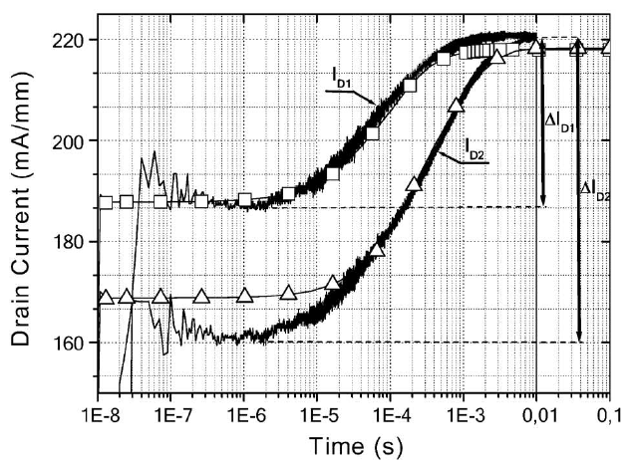
Motivation
Dynamic ON-resistance (R_{ON}) a.k.a. “current collapse”
Tirado et al, TED 2007

Slide 4
Motivation
Dynamic ON-resistance (R_{ON}) a.k.a. “current collapse”
Tirado et al, TED 2007
Primary concern in GaN power-switching and RF power-amplifier devices

Slide 5
Motivation
Much less understanding
Impact of electrical stress on dynamic R_{ON}
Especially, high-power (HP) state in GaN device operation

Slide 6
Motivation
Much less understanding
Impact of electrical stress on dynamic R_{ON}
Especially, high-power (HP) state in GaN device operation
< RF-amplifier >
< Power-switching >

Slide 7
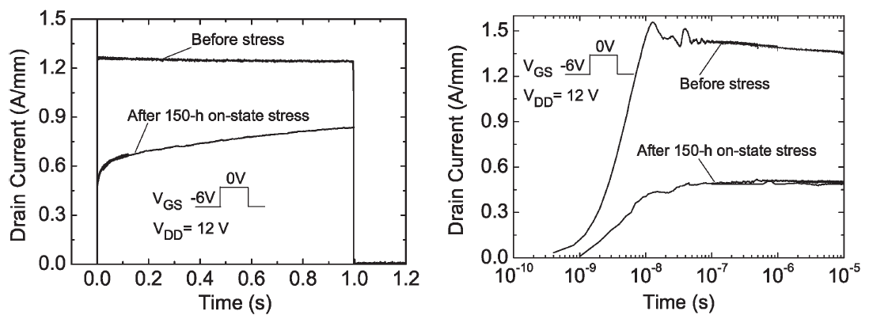
Motivation
Much less understanding
Impact of electrical stress on dynamic R_{ON}
Especially, high-power (HP) state in GaN device operation
Meneghesso et al, TED 2006

Slide 8
Motivation
Much less understanding
Impact of electrical stress on dynamic R_{ON}
Especially, high-power (HP) state in GaN device operation
Meneghesso et al, TED 2006
Goal
New methodology for dynamic R_{ON} measurement
Investigate the impact of high-power stress on dynamic R_{ON}

Slide 9
Outline
Motivation
Dynamic ON-resistance measurement
High-power stress experiment
Discussion
Conclusion

Slide 10
Dynamic R_{ON} measurement
New methodology for R_{ON} transient measurement
from 200 ns to any arbitrary length of time
Auriga AU4750 pulsed-IV for R_{ON}(200 ns ≤ t ≤ 3 ms) +
Agilent B1500A SDA for R_{ON}(3ms < t )

Slide 11
Dynamic R_{ON} measurement
New methodology for R_{ON} transient measurement
from 200 ns to any arbitrary length of time
Auriga AU4750 pulsed-IV for R_{ON}(200 ns ≤ t ≤ 3 ms) +
Agilent B1500A SDA for R_{ON}(3ms < t )
Dynamic R_{ON} measurement from pulsed-IV

Slide 12
Dynamic R_{ON} measurement
New methodology for R_{ON} transient measurement
from 200 ns to any arbitrary length of time
Auriga AU4750 pulsed-IV for R_{ON}(200 ns ≤ t ≤ 3 ms) +
Agilent B1500A SDA for R_{ON}(3ms < t )
Dynamic R_{ON} measurement from pulsed-IV
V_{DS}
V_{DSQ}
Synchronous switching of V_{GS} and V_{DS}
V_{GS}
t
t
1 V
V_{GSQ}

Slide 13
Dynamic R_{ON} measurement
R_{ON}(t) from I_{D}(t)-V_{DS} measurements
Q(V_{GSQ}= -10 V, V_{DSQ}= 50 V)
I_{D}(200 ns ≤ t ≤ 3 ms)
@ V_{GS}= 1 V, V_{DS} ≤ 1.2 V

Slide 14
Dynamic R_{ON} measurement
R_{ON}(t) from I_{D}(t)-V_{DS} measurements
Q(V_{GSQ}= -10 V, V_{DSQ}= 50 V)
I_{D}(t= 1 ms) @ V_{GS}= 1 V
100 μs
10 μs
I_{D}(200 ns ≤ t ≤ 3 ms)
@ V_{GS}= 1 V, V_{DS} ≤ 1.2 V
200 ns
1/R_{ON}
Extract R_{ON} transients from 200 ns up to 3 ms in OFF-to-ON

Slide 15
Dynamic R_{ON} measurement
Q(-5 V, 40 V)
* Virgin GaN-on-SiC HEMT sample
Pulsed-IV
200 ns ≤ t ≤ 3 ms
R_{ON_DC}= 3.5 Ω∙mm

Slide 16
Dynamic R_{ON} measurement
OFF(-5 V, 40 V) to ON
Q(-5 V, 40 V)
Semiconductor Device Analyzer
* Virgin GaN-on-SiC HEMT sample
Pulsed-IV
200 ns ≤ t ≤ 3 ms
3 ms ≤ t ≤ 2.8 hr
R_{ON_DC}= 3.5 Ω∙mm

Slide 17
Dynamic R_{ON} measurement
OFF(-5 V, 40 V) to ON
Q(-5 V, 40 V)
Semiconductor Device Analyzer
* Virgin GaN-on-SiC HEMT sample
Pulsed-IV
200 ns ≤ t ≤ 3 ms
3 ms ≤ t ≤ 2.8 hr
R_{ON_DC}= 3.5 Ω∙mm
R_{ON} transients over 11 decades in time
→ details in DJin ISPSD 2012

Slide 18
Outline
Motivation
Dynamic ON-resistance measurement
High-power stress experiment
Discussion
Conclusion

Slide 19
High-power DC-stress
* Constant HP-stress: V_{DS}= 20 V, I_{D}≈0.6 A/mm, P≈12 W/mm
t_{stress}= 10, 20, 30, 40 min (4 samples)
* t_{stress}= 40 min sample
Prominent degradation in R_{ON} and I_{DMAX}; minor in I_{GOFF}
Dynamic R_{ON} measurement after each HP-stress test

Slide 20
Dynamic R_{ON} transients
Transient from
OFF (V_{GSQ}= -10 V, V_{DSQ}= 50 V)
to ON (V_{GS}= 1 V, V_{DS} ≤ 1.2 V)
HP-stress time | R_{ON_DC} increase
10 | 7%
20 | 8%
30 | 11%
40 | 16%
t_{stress}= 40 min
30
20
10
Virgin
Dynamic R_{ON}↑ ≥ 10 x R_{ON_DC} after 40 min HP-stress
- Up to 30 min: minor increases in dynamic R_{ON}
In contrast, small R_{ON_DC}↑ (16%)
- minor permanent (non-transient) degradation
Fast R_{ON} recovery in ms range in all cases

Slide 21
Time constant spectrum
40 min HP-stress → fast transient with short time constants (μs ≤ τ ≤ ms) ↑
In contrast, negligible changes in long time constants

Slide 22
Dynamic R_{ON} at different T
* t_{stress}= 40 min sample
As T ↑, R_{ON} transients substantially accelerated
R_{ON} transients → conventional traps

Slide 23
Time constant spectrum at different T
* t_{stress}= 40 min sample
Evolution of dominant time constant peaks at different T

Slide 24
Arrhenius plot
Dominant trap energy levels at 0.31, 0.45, 0.53 and 0.57 eV
(below E_{C} of AlGaN barrier)
Responsible for dramatic increase in dynamic R_{ON}

Slide 25
Outline
Motivation
Dynamic ON-resistance measurement
High-power stress experiment
Discussion
Conclusion

Slide 26
Discussion:
HP-stress with higher V_{DS}
Transient from OFF (-10 V, 50 V) to ON
After 3 min HP-stress with
V_{DS}= 30 V, P≈ 9 W/mm
After 20 min HP-stress with
V_{DS}= 20 V, P≈ 12 W/mm
Virgin
Fast dynamic R_{ON} ↑ only in 3 min with lower P-level
Again, very fast R_{ON} recovery down to ms range
HP-stress with V_{DS}↑ promotes fast dynamic R_{ON} degradation

Slide 27
Discussion:
Different epi-supplier
* Red solid line: same GaN-on-SiC HEMT design processed in the same lot on nominally identical epitaxial wafer from different epi-supplier (denoted by epi-supplier II)
Transient from OFF (-5 V, 40 V) to ON
virgin epi-supplier II
virgin epi-supplier I
R_{ON_DC}= 4.6 Ω∙mm
R_{ON_DC}= 3.5 Ω∙mm
Very different patterns of dynamic R_{ON} transient

Slide 28
Discussion:
HP-stress on epi-supplier II
* HP-stress on epi-supplier II device: V_{DS}= 20 V, I_{D}≈ 0.6 A/mm, P≈ 12 W/mm
I_{DMAX}
R_{ON}
I_{GOFF}
No prominent permanent degradation in R_{ON}, I_{DMAX} and I_{GOFF}
- Large increase of I_{GOFF} recoverable

Slide 29
Discussion:
Dynamic R_{ON} on epi-supplier II
OFF(-10 V, 50 V) to ON
40 min HP-stress
on epi-supplier I
2 hr HP-stress
on epi-supplier II
Virgin epi-supplier II
Minor increase in dynamic R_{ON} up to 2 hr HP-stress
Epi-supplier II device more robust than epi-supplier I
- R_{TH}(thermal resistance) of epi-supplier II < R_{TH} of epi-supplier I
- Better heat dissipation through different buffer design
Epi-supplier II wafer more traps than epi-supplier I

Slide 30
Outline
Motivation
Dynamic ON-resistance measurement
High-power stress experiment
Discussion
Conclusion

Slide 31
Conclusion
Developed new dynamic R_{ON} measurement methodology
Key findings from HP electrical stress
- Large increase in dynamic R_{ON} on a short-time scale
- Formation of shallow traps most likely inside the AlGaN barrier or at its surface
GaN HEMTs device operation under RF power or hard-switching conditions
- Undesirable increase of dynamic R_{ON} on a very short time scale

